Slide 1
Workshop for Academic Mentors and Host Institution Representatives
2023 Philipp Schwartz and Inspireurope+ Stakeholder Forum
May 24th 2023

Slide 2
INSPIREUROPE+ FACTS
Title: Initiative to Support, Promote and Integrate Researchers at Risk in Europe PLUS
Duration: September 2022 to August 2025
Coordinator: SAR Europe at Maynooth University, Ireland
Consortium: 6 project partners, 4 associated partners, 9 advisory board members
Funder: European Union’s Marie Skłodowska-Curie Actions (MSCA), Horizon Europe

Slide 3
SPEAKERS
Marija Fedotovaite, MSCA Unit, DG EAC
Malamati Tsapoutzoglou, Aristotle University of Thessaloniki
Yudit Namer, University of Twente
Sarina Rosenthal, Scholars at Risk
Karolina Catoni, University of Gothenburg

Slide 4
EU-funded Opportunities and Inclusion of Researchers at Risk
24 May 2023

Slide 5
EU support for researchers at risk
Information provision
Coordination of national efforts
Policy instruments
Funding instruments
MSCA
Erasmus+
ERC
MSCA4Ukraine…

Slide 6
Marie Skłodowska-Curie Actions (MSCA)
Researchers’ training, skills and career development (all stages of career)
Attractive working and employment conditions
Structuring impact on organisations
Excellent research in all domains (bottom-up approach)
International, cross-sectoral & interdisciplinary mobility
Strong collaboration with industry and SMEs
Flagship programme for training & mobility of researchers
Part of Horizon Europe (€ 95.5 bn)
Budget: € 6.6 billion (2021-2027)
Worldwide geographic coverage
Open to any nationality, including researchers at risk
MSCA Work Programme, p.8:
“MSCA projects are also encouraged to facilitate access by researchers at risk, through tailored support and career services, including job search assistance in the researcher’s new geographical area.”

Slide 7
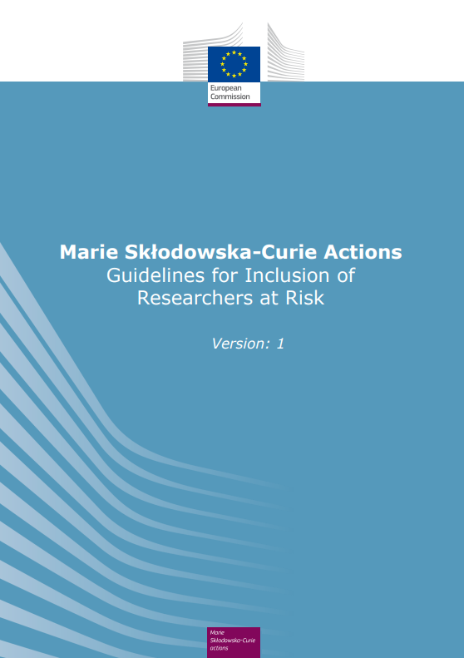
Guidelines on the Inclusion of Researchers at Risk
Who are researchers at risk?
Why supporting researchers at risk is important?
How you can support researchers at risk through some best practice examples and main recommendations
Where to find more information
https://marie-sklodowska-curie-actions.ec.europa.eu/about-msca/guidelines-for-inclusion-of-researchers-at-risk

Slide 8
Recommended practices
Dissemination
Communicate open calls for recruitment (to Inspireurope or Scholars at Risk Europe)
Mention researchers at risk in recruitment calls (e.g. on website or social media)
Application, selection and recruitment
Dedicated section/webpage with information for researchers at risk
Tailored advice and guidance (e.g. dedicated contact point)
Take into consideration the specific situation of researchers at risk during the selection process (e.g. independent experts in selection committees / briefing of selection committee)
Be sensitive to security concerns (i.e. protect researchers’ confidentiality)
Pre-arrival and post-arrival measures
Consult existing resources & organisations (e.g. Erasmus+ Academic Refuge project’s How to Host Curriculum)
Designate academic/administrative mentors + provide training
Career development & training opportunities (e.g. language courses / transferable skills)
*Recommendations to be implemented on a “best effort” basis (they are not part of contractual obligations)

Slide 9
MSCA Actions
Doctoral Networks
Doctoral programmes in and outside academia incl. joint & industrial doctorates
COFUND
Co-funding doctoral and postdoctoral programmes
Postdoctoral Fellowships
Support to excellent postdoctoral researchers
Staff Exchanges
Support for research and innovation staff exchanges

Slide 10
Mobility Rule (for PF, DN, COFUND)
Recruited researchers can be of any nationality.
They must not have resided/carried out their main activity (work, studies, etc.) in the country of the recruiting beneficiary for more than 12 months in the 36 months before their recruitment date/the deadline of the co-funded programme’s call.
Time spent by the researcher as part of a procedure for obtaining refugee status under the Geneva Convention* is not taken into account.
*1951 Refugee Convention and the 1967 Protocol

Slide 11
MSCA Postdoctoral Fellowships
Target group: postdoctoral researchers
Two destinations:
European Fellowships: 12-24 months in EU or Associated Countries (AC)
Global Fellowships: 12-24 months outside EU/AC + 12 months return
+ 6 months for placements in non-academic organisations in Europe (optional)
Who applies:
Researcher applies with single legal entity based in the EU / AC
Third countries can take part as associated partners (to host researchers during secondments or Global Fellowships)

Slide 12
MSCA Doctoral Networks
Support to set up doctoral programmes
Who applies?
At least 3 organisations from different EU MS or AC
On top of this, any organisation can join as associated partner or beneficiary*
Target group: Doctoral candidates
Vacancy notices widely advertised, including on EURAXESS
Duration:
Project: 48 months
Fellowships: 3 to 36 months (on the basis of full-time employment)

Slide 13
MSCA COFUND
Support to co-fund new or existing national, regional, institutional doctoral programmes and postdoctoral fellowship schemes
Target group: doctoral candidates and postdoctoral researchers
Who applies?
Single legal entity established in an EU MS or AC
EU contribution:
Max 10M€ per beneficiary per call
Duration:
Project: Max 60 months

Slide 14
MSCA Staff Exchanges
Support to exchange staff in Europe and beyond
Target group: research, technical, administrative and managerial staff employed at the sending institution
Duration:
Project: 48 months
Individual mobility: 1-12 months
Who applies?
Consortia of at least 3 legal entities in 3 different countries (2 should be in different EU MS or AC)
On top of this, any organisations can participate

Slide 15
MSCA funding
MSCA action | Researcher Unit Cost (Euro per person month) |  |  | Institutional Unit Cost
 | Living Allowance | Mobility Allowance | Family Allowance | Research, Training and Networking | Management and Indirect Costs
Doctoral Networks | 3400 | 600 | 660 | 1600 | 1200
Postdoctoral Fellowships | 5080 | 600 | 660 | 1000 | 650
Living allowance covers compulsory deduction under national law (social security, taxes…) Mobility allowance covers private mobility-related costs (travel and accommodation) Costs that contribute directly to the researchers’ career development (e.g. language courses) are eligible costs under Research, Training and Networking If applicable, additional long-term leave (e.g. maternity, paternity, sick leave) & special needs allowances Country correction coefficients apply to the living allowance

Slide 16
MSCA Call Calendar 2022
Year | Action | Opening | Deadline
2023 | Postdoctoral Fellowships | 12 April 2023 | 13 September 2023
 | Doctoral Networks | 30 May 2023 | 28 November 2023
 | Staff Exchanges | 5 October 2023 | 28 February 2024
 | COFUND | 10 October 2023 | 8 February 2024
All calls are published on the Funding and Tender Opportunities Portal

Slide 17
For organisations
Find your call on the Funding and Tenders Portal
Check the relevant documents (Guide for applicants, MSCA Work Programme, Proposal templates, Model Grant Agreements, FAQs)
Check the Portal and social media to find out about webinars organised by the European Commission / REA / Euraxess / Marie Curie Alumni Association
Sign in to the portal and register your organisation (get a PIC number)
Get guidance from MSCA National Contact Points
Find partners on the Portal or publish offers to host researchers on EURAXESS
Apply!
https://ec.europa.eu/info/funding-tenders/opportunities/portal/screen/home

Slide 18
For individuals
MSCA | Position | Where to find vacancies | Where to apply | Deadline
Doctoral Networks | PhD | EURAXESS | Directly to programme | Depends on programme
Postdoctoral Fellowships | Postdoc | Host organisation in Europe | Funding & Tenders Portal | 13 Sep 2023
COFUND | PhD Postdoc | EURAXESS | Directly to programme | Depends on programme
Staff Exchanges | R&I staff | (no recruitment; staff is exchanged between organisations) | Through the sending institution | Depends on project
Researchers at risk can participate in all MSCA actions

Slide 19
Find offers
https://euraxess.ec.europa.eu/jobs
PhD & postdoc positions in Europe and beyond

Slide 20
science4refugees | EURAXESS (europa.eu)

Slide 21
ERA4Ukraine | EURAXESS (europa.eu)

Slide 22
Preparatory action for Researchers at Risk
Preparatory actions are experimental initiatives designed to test the feasibility of new actions and prepare new programmes
Support for researchers at risk from outside EU
Around 30 fellowships for doctoral or postdoctoral researchers
Open to any field of research both in academic and non-academic sectors
Open call to set up the scheme will be launched this summer.

Slide 23
Key resources and guidance
Marie Skłodowska-Curie Actions Website
Funding and Tenders Portal (applications, documents, partner search)
Euraxess (post/find PhD and postdoctoral vacancies, hosting offers, more information on careers)
List of MSCA National Contact Points
MCAA (Marie Curie Alumni association)
MSCA Guidelines on Inclusion of Researchers at Risk
MSCA Guidelines on Supervision

Slide 24
Preparing to host Malamati Tsapoutzoglou Inspireurope+, AUTh & SAR Greece

Slide 25
Preparing to host at risk scholars in a HEI
Usually a top-down approach (decision to host, funding) but down-top may bring immediate results
No-one size fits all
HEIs in different countries differ in employment regulations and funding opportunities
Researchers at risk are not a homogeneous group
(country of origin, current residence, legal status, family, etc. AND academic profile)

Slide 26
Preparing to host at risk scholars in a HEI
Key elements for successful preparation of hosting
Building support within the Institution
Good fit between the scholar and the host institution
Good planning in advance
Effective communication and collaboration of all parties involved

Slide 27
Preparing to host at risk scholars in a HEI
Building support within the Institution
Raise awareness (leadership, academic and administrative staff)
Get people involved
Secure financial support (full funding or subsidiary) or other types of support (e.g. housing in University facilities)
Good fit between the scholar and the host institution
Selection procedures (academic criteria)
Academic mentorship
Cooperation and guidance on the research and academic part
Inclusion in their Lab, Department and School
Academic networking

Slide 28
Good planning in advance
Provide the scholar with necessary information on legal, work and University-specific regulations), e.g. AUTh’s Welcome Guide https://inspireurope.auth.gr/welcomeguide/
Appoint a contact person, e.g. from international office or Welcome center (at AUTh SAR Greece members take up this role)
Regular communications with the scholar (before and after arrival)
To create a safety and trust environment
To assist in travel arrangements
To organize/coordinate welcome and orientation activities
To provide information AND practical support about:
The University, its facilities and services
Employment contract and payment
Legal-administrative issues (work permit, social security and Tax Identification numbers, etc)
Communication with other public services
Banking
Housing
Health Care Services
Psychosocial support Services
Schooling (if needed)

Slide 29
Communication and collaboration of all parties involved
Necessary for planning supportive measures for a successful hosting
The example of the Host Statement Document for MSCA4 Ukraine
AUTh’ s host statement was prepared jointly by:
International Relations Office
Department of European Educational Programs
Research Committee
Career Office
School of Modern Greek Language
Centre for Psychological Support
Includes different types of support according to the different needs of the two applicants, e.g.
Language
Psychological Counselling (dealing with trauma)
Professional counselling
Guidance on submitting research proposals
Training opportunities for academic development
Social networking- inclusion in the community (in collaboration with the Municipality services and NGOs working in related fields)
Planning for the family

Slide 30
During a placement
Academic mentor + administrative contact person.
Open discussion on expectations and goals with the scholar. What is realistic and not?
Put together a plan for the placement.
Adapt the career path to the goals
Professional development: trainings, courses, seminars, networking, peer-to-peer learning.
Knowledge in European and national research structures, calls etc.
Publication strategies

Slide 31
Transitioning
Start the discussion early on.
Involve academic mentors, SAR, your national/ regional network.
If the goal is to continue in academia:
Publicly announced positions
MSCA
National or European research funding
A second SAR placement possible?
Industry/ civil society as employers

Slide 32
Yudit Namer
University of Twente

Slide 33
Sarina Rosenthal
Scholars at Risk

Slide 34
Resources and further reading
Publications and Guides on Hosting Researchers at Risk
Scholars at Risk How to Host Handbook
Welcoming at risk scholars to campus (EAIE)
How to Host Training Curriculum (developed by the Academic Refuge Project)
Council for At-Risk Academics (CARA) Handbook for mentors and mentees
PAUSE’s Welcome Handbook for Host Institutions
Report on Workshop on Mentoring Researchers at Risk
https://sareurope.eu/sar-resources/resources-for-hosting-or-employing-scholars-and-researchers-at-risk/

Slide 35
CONNECT WITH US
Visit www.sareurope.eu/inspireurope/
Email inspireurope@mu.ie
@Inspire_MSCA
@Inspireurope

Slide 36
Group discussion
1. Which functions within HEIs are important to involve during hosting to make hosting successful?
2. What kind of support is needed for a successful academic mentoring where the scholar is growing professionally during a placement? Either existing support or support you would have wishes for/ needed?
3. How can we secure lateral learning between countries?

