Slide 2
Through incentive funding, PAUSE facilitate hosting for scientists and artists in exile at higher education and research institutions in France. We also help them with administrative procedures and support their career development.

Slide 3

An historical precedent
Genesis
1936 : Louis Rapkine’s « Comité d’accueil »
During the Front populaire, Louis Rapkine, from a Belarusian family that had migrated to France, created the "Committee for the Reception and Organization of the Work of Foreign Scientists" with the support of several scientists: Paul Langevin, Jean Perrin, Edmond Bauer, Frédéric and Irène Joliot-Curie, Jacques Hadamard...

Slide 4

Creation of PAUSE
August 2015 : Assassination of Khaled al-Assaad, the former director of antiquities and museums of Palmyra in Syria, and mobilization of the archaeological community
October 2016 : Announcement of the creation of a reception mechanism for researchers in exile and creation of a support committee during the Collège de France's annual conference on "Migration, refugees, exile".
January 2017 : Official launch of PAUSE with the signing of the framework agreement between the Ministry of, Higher Education and Research, the Collège de France and the Chancellerie des Universités de Paris

Slide 5
Missions
Co-funding of institutions seeking to host a scientist or artist forced into exile through three calls for applications per year.
Support for researchers and artists with identifying a host institution and accessing common law services
Accompaniment of beneficiaries towards a sustainable professional insertion.
Advocacy actions to uphold academic and artistic freedom and protect researchers and artists in exile.
International and European cooperation with similar programs abroad and stakeholders working to help at-risk scholars and artists.

Slide 6
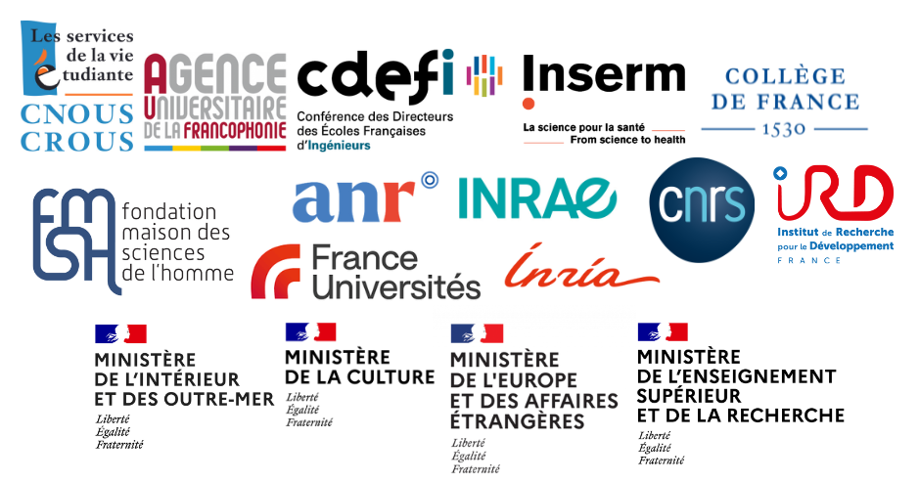
Governance
Executive Committee
Program Management Office
Executive Director
Communication, Advocacy and International Relations Officer
Finance and Fundraising Officer
Manager of the hosting projects unit
Integration and Career development Officers (2)
Focal points with host institutions (2)
Arts and Culture Officer
Support Committee
Scientific & Artistic Committees
Ambassadors of the program
Researchers and experts in charge of examining the applications

Slide 7
Who is eligible?
Doctoral student, Researcher, Professor or Artist who can justify his/her status
In an emergency situation due to the security context, persecution because of his/her ethnic origin, political commitment, opinions, or the content of his/her research and/or teaching
Regardless of his/her current place of residence: being forced into exile or has been forced to leave his/her country of origin less than 3 years ago.
Threats faced by at-risk scientists and artists:

Slide 8
PAUSE
in figures

Slide 9
Overview
6 years after its launch
374
for an additional year
21
Calls for applications
584
Scientists and artists supported
165
Trainings to facilitate professional insertion
188
Alumni of which 2/3 found new opportunities or are in transition
+177
hosted for 3 months within the framework of the emergency funds
PAUSE - Solidarity with Ukraine

Slide 10





Beneficiaries’ profile
41
countries
51%
men
49%
women
25%
PhD students
49%
post-doctoral researchers
16%
senior researchers and research fellows
10%
artists and artists-teachers
10 %
12 %
55 %
23 %

Slide 11


Partner institutions
123
3
5
43
5
Partner institutions
7
2
4
2
11 institutions hosting more than 10 scholars or artists
35 % of scholars hosted in
Ile-de-France region
65 % of scholars hosted in other regions of France
4
15
21
11
1

Slide 12
Alumni
As of 1st January 2023
69 found new opportunities (fixed-term or permanent contracts, etc.), of whom
14 returned to their country of origin
29 in transition (trainings, scholarships, entrepreneurship)
50 seeking employment or funding returned to their country of origin
30 unknown
192
alumni

Slide 13
Challenges
and perspectives

Slide 14

On a national scale
To perpetuate and increase PAUSE funding: Endowment of the French public actors (Ministry of Higher Education and Research, Ministry of Culture), private donators, EU funds.
Increase the number of researchers and artists hosted by mobilizing new host institutions
Adapt and organize responses to political and humanitarian crises
  Afghanistan
  Ukraine
Accompany the professional integration of beneficiaries after the program support:
  Allocation of additional funding of up to €5,000 upon presentation of a training plan by host institutions
  Organization of workshops and personalized support in collaboration with integration professionals
  Creation of an alumni network for PAUSE beneficiaries
  Contribution to research projects and valorization of the PAUSE laureates’ expertise through the organization of scientific and cultural events

Slide 15






On an international scale
Develop European and International partnerships to strenghten the reception and integration of scientists and artists in exile
  Bilateral cooperation with counterpart programs in Europe and internationnaly:
  participation in European projects InSPIREurope and InSPIREurope+
  Associate partner MSCA4UKRAINE

Slide 16
On an international scale
Contribute to advocacy activities for the protection of academic and artistic freedom and support of scholars and artists at-risk
  Participation in the European Coordination Committee for Academic Freedom Advocacy
  Participation in the International project Science in Exile
  Artists at risk connection (ACR)

Slide 17

For more information: www.programmepause.fr
@Programme_PAUSE

