Slide 1
Funding Opportunities for Researchers at Risk
The Philipp Schwartz Initiative
Division Philipp Schwatz Initiative
and Academic Freedom
Alexander von Humboldt Foundation

Slide 2

The Alexander von Humboldt Foundation
    Research fellowships and research awards for researchers from abroad
    Chosen research project with a a host and collaborative partner in Germany
    Alexander von Humboldt Professorship: Germany’s most valuable research award
2 | 21.12.2023

Slide 3
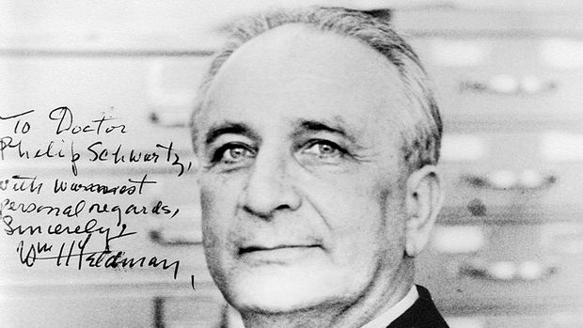
The “Philipp Schwartz Initiative”
for researchers at risk
Philipp Schwartz
Professor of Pathology at the University of Frankfurt
dismissed in 1933 under the “Law for the Restoration of the Professional Civil Service” (Berufsbeamtengesetz) and fled Germany to escape arrest
founded the “Notgemeinschaft deutscher Wissenschaftler im Ausland”
placed nearly 2,000 dismissed academics in posts abroad until 1946

Slide 4
THREE COMPONENTS
1. Individual Support to Researchers
2. Capacity-Building
3. Networks

Slide 5
Philipp Schwartz Initiative - Facts & Figures
Established in 2016
For researchers at severe and acute individual risk, in all academic disciplines, from all countries of origin outside EU
PostDocs to Senior Professors
Fully-funded 24-month fellowships
Optional 12-month extension (co-financed with host institution)
Steady State pre-2022: 50 fellowships per year in 2 annual calls for nominations
Notes:
At-risk scholars in all academic disciplines, from all countries of origin outside EU

Slide 6
Facts & Figures – as of November 2023
>480
Philipp Schwartz Fellows
>125
Host Institutions
59% male
41% female
0.2% non-binary
26
    Countries of Origin:
    Turkey, Ukraine, Syria, Afghanistan, Iran, …
27
Preparatory Fellowships under
PSI Emergency Fund Ukraine
20
Bridging Fellowships under
Special Programme Afghanistan
12
Fellowships under
Special Programme Iran

Slide 7
Higher education institutions as applicants and beneficiaries
Partnerships: SAR, CARA, PAUSE…
Networks: SAR Germany, Inspireurope
Events: Philipp Schwartz Forum,
Inspireurope Stakeholder Forum
Higher Education Institution:
As Applicant:
    Hosting concept
    Nomination
    3rd Party Risk Assessment
AvH:
Selection
Funding
Advice
Networks
Higher Education Institution:
    As Grantee:
    Builds support structures
    Awards fellowships
    Advises and supports fellows
Funding
German Federal Foreign Office
Private Foundations and Donors

Slide 8
Host institutions – role and responsabilities
Auxiliary funds for the host institution: 20,000 EUR per fellow hosted
    preparing for the transition phase at the end of the fellowship
    raising awareness concerning the issue of "threatened researchers“
    developing measures for networking activities and the individual researchers, e.g. language courses, career training, coaching, initiation of job shadowing or internship programmes, participation in research related and vocational events
    to help establish long-term support structures

Slide 9
Host institutions – roles and responsabilities (2)
Institution in general:
  Development of a concept for the creation of a sustainable support infrastructure for threatened researchers
Programme manager:
  Responsible for administration of funding,
  disbursement of fellowships,
  main contact point for Alexander von Humboldt Foundation
Academic mentor:
  Responsible for scientific advice and support
  Ideally active collaboration with guest researcher

Slide 10
Selection Criteria
Does the combination of
the support concept of the host institution
the fit between the nominee - and their research project - and the intended academic mentor
the academic qualification of the nominee
the commitment of the host institution to the nominee
concrete support measures on the part of the host institution and the mentor
perspectives for the time after the end of the funding
appear likely to prepare the nominee for a successful new start in an academic or academia-related career in the country of origin, in Germany or a third country?

Slide 11
Challenging Transitions
Return as the primary objective
If return is impossible: Move from protection to regular positions/programmes
Challenges:
  Assessment criteria/metrics of academic output
  Access to competitive academic labour markets
  Identify and pursue alternative career options beyond academia

Slide 12
Current Challenges for the PSI:
Crisis Response versus Individual Support
Since August 2021: continuous crisis response-scale demand for all protection programmes
Overlapping crises: Belarus, Afghanistan, Ukraine, Iran…
2022 and 2023
  Several Special Initiatives to respond to individual crises
  Sharp increase in nomination numbers for general programme

Slide 13

MSCA4Ukraine for displaced researchers from Ukraine
Part of the EU response to Russian Federation’s invasion of Ukraine
Enables doctoral and postdoctoral researchers to continue their work at academic and non-academic institutions in EU and Horizon Europe associated countries:
>120 MSCA4Ukraine fellows
> 20 host countries
Total programme budget: 25 million EUR

Slide 14
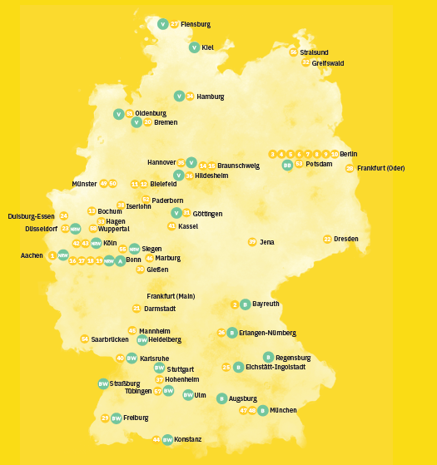

    58 members (May 2023)
    Regional Networks:
      Baden Württemberg
      Bavaria
      Berlin Brandenburg
      Northern Germany
      Northrine Westphalia
    Founded and coordinated by AvH
      elected coordinator until March 2025
    Platform for
      exchange and mutual support
      events
      networking
    Website hosted by AvH: information, best practices, additional funding opportunities

Slide 15





Partners
For Students at Risk:

Slide 16
Resources
Philipp Schwartz Initiative:
https://www.humboldt-foundation.de/en/apply/sponsorship-programmes/philipp-schwartz-initiative
MSCA4Ukraine:
https://sareurope.eu/msca4ukraine/
Funding opportunities and other resources for researchers at risk (incl. links to PAUSE, SRF etc.):
https://www.humboldt-foundation.de/en/apply/sponsorship-programmes/philipp-schwartz-initiative/sponsorship-opportunities-for-researchers-at-risk
https://sareurope.eu/inspireurope/inspireurope-resources/
For students at risk:
https://www.daad.de/en/study-and-research-in-germany/scholarships/hilde-domin-programm/

Slide 17

Contact
Frank Albrecht
Division „Philipp Schwartz Initiative and Academic Freedom“
Alexander von Humboldt Foundation
schwartz-initiative@avh.de
msca4ukraine@avh.de

