Slide 1
Open Science in Horizon Europe & Open Research Europe
Victoria Tsoukala, PhD
Policy Officer, Unit for Open Science
DG Research & Innovation
European Commission
MSCA4Ukraine Open Science Webinar
October 25, 2023

Slide 2
Open Science policy
Open Science @ Horizon Europe
Open Research Europe: The open access publishing platform of the EC

Slide 3
1. Open Science Policy @ the EC: an introduction

Slide 4
What is Open Science?
“Open science” means an approach to the scientific process based on open cooperative work, tools and diffusing knowledge
(Horizon Europe Regulation and Model Grant Agreement)

Slide 5
Why open science?
Improves research QUALITY: transparent, accessible, reusable methods and outputs - facilitate verifiability and reproducibility of research results - leading to higher robustness and reliability
Accelerates research EFFICIENCY: sharing and reuse of methods and outputs - enables researchers to build upon others’ work more easily and quickly - leading to faster research progress
Enhances IMPACT of research: research methods and outputs visible and accessible to public and private sectors - facilitate their inclusiveness, valorisation and practical application - leading to enhanced trust in research and increased uptake and use of research outputs

Slide 6
<50%
Authors who retain copyright in contracts with largest subscription journals
Scientific publications available in open access
<20%
3€ billion per year
Researchers who put FAIR principles into practice
National public funding for pan-European Research Infrastructures
Importance of publishing and attracting external funding in a researcher’s career
Researchers who occasionally store research data in shared/non-local repositories
>80%

Slide 7
Open Science at the centre of European research policy
2018
Recommendation on access to and preservation of scientific information
2020
Commission Communication on ‘A new ERA for Research & Innovation’
2021
Council Recommendation on ‘A Pact for Research and Innovation in Europe’
Council Conclusions on the ‘Future governance of the European Research Area’
2022
2023
Council Conclusions on ‘Research assessment and implementation of Open Science’
Council Conclusions on ‘High-quality, transparent, open, trustworthy and equitable scholarly publishing’

Slide 8
Embracing open science as the modus operandi of research
Improving the practice
Providing immediate and unrestricted open access to scientific publications, research data, models, algorithms, software, protocols, notebooks, workflows, and all other research outputs
Research output management - publications, data, and other outputs - in line with FAIR principles
Early and open sharing of research, e.g.
Pre-registration, registered reports, data deposition in shared repositories, pre-prints
Ensuring verifiability and reproducibility of research outputs
Open collaboration within science and with other knowledge producers/users, incl. citizens, civil society and end users
Developing the enablers
Incentives and rewards to adopt open science practices, e.g. initiative for Reforming Research Assessment
Legislative and regulatory environment for practicing open science
An EU data, copyright and digital legislative framework fit for research
Horizon Europe provisions on Open Access and Open Science practices
Open research infrastructures and skills e.g.
European Open Science Cloud (EOSC) virtual research environment
Open Research Europe (ORE) open access publishing service
Support for skills and education for practicing open science & data-intensive research

Slide 9
2. Open Science @Horizon Europe

Slide 10
Open Science in Horizon Europe
Evolution of Open Science policies across Framework Programmes
Under Horizon Europe (2021)
Open Science embedded across Horizon Europe
Strengthening of the open access obligations and focus on responsible research data management in line with the FAIR principles
FP7
Pilot on open access to publications
H2020
Open access to publications mandatory
& Pilot on open research data/DMP
H2020
Open access to publications mandatory
& Open research data/DMP by default
(exceptions)
2017
2014
2008

Slide 11
Horizon Europe strategy: reflecting the policy
Open Access to peer-reviewed scientific publications (mandatory, no exceptions) - Immediate OA via trusted repository under CC-BY; metadata under CC0 - Information about data and tools needed to validate conclusions - IPR retention to comply with OA requirements - Reimburse only if in full OA venue
Research Data Management (RDM mandatory; OA mandatory with exceptions) - RDM in line with FAIR, mandatory Data Management Plan - OA via repository under CC-BY or CC0; metadata under CC0; exceptions to OA possible (‘as open as possible, as closed as necessary’) - Information about software and other tools needed to reuse or validate data
Additional OS practices (encouraged) - Providing OA to research outputs beyond publications and data - Research output management beyond publications and data - Early and open sharing of research, e.g. preregistration, registered reports, preprints - Measures to ensure reproducibility of research outputs - Involving citizens and end users in co-creating R&I agendas and content

Slide 12
Exceptions to open access to research data
Data may be kept closed if:
providing open access is against the beneficiary’s legitimate interests, including regarding commercial exploitation;
it is contrary to any other constraints, such as data protection rules, privacy, confidentiality, trade secrets, Union competitive interests, security rules, intellectual property rights or would be against other obligations under the Grant Agreement.

Slide 13
Evaluation of proposals and Open Science
“Quality and efficiency of implementation” criterion
(capacity of participants and consortium as a whole + list of achievements)
Explain expertise/track record on Open Science
List publications, software, data, etc, relevant to the project with qualitative assessment and, where available, persistent identifiers
Publications are expected to be open access; datasets are expected to be FAIR and ‘as open as possible, as closed as necessary‘. Significance of publications to be evaluated on the basis of proposers’ qualitative assessment and not per Journal Impact Factor
“Excellence” criterion
(methodology)
Evaluation of the quality of open science practices
E.g.1 page to describe Open Science practices + 1 page to describe research data/output management [RIA,IA]

Slide 14
Trusted repositories under Horizon Europe
Trusted repositories are either certified repositories (e.g. CoreTrustSeal, nestor Seal DIN31644, ISO16363) and/or disciplinary/domain repositories that are commonly used/endorsed by the research communities (e.g. ELIXIR deposition databases).
General-purpose repositories and institutional repositories are, in general, also acceptable.
Trusted repositories share essential properties:
Mechanisms to ensure integrity and authenticity of contents.
Offer clear information about their policies/services.
Provide broad, and ideally open access to content (consistent with legal and ethical constraints).
Assign PIDs, ask for detailed metadata in a standardized (e.g. Dublin Core) and machine-readable way.
Ensure mid- and long-term preservation of contents, expert curation, quality assurance.
Meet national and/or international security criteria

Slide 15
Resources
To understand open science in preparation of your proposal
To understand well the mandatory requirements for beneficiaries
To understand how OS is evaluated
To prepare for DMP
Read the HE Programme Guide
Read the Annotated Grant Agreement
Read the HE Programme Guide and watch the support video for evaluators
Consult and/or use the DMP template (under reference documents>funding& tenders portal)

Slide 16
3. Open Research Europe

Slide 17
Open Research Europe (ORE)
Peer-reviewed open access publishing platform (not a repository)
Platform for Horizon 2020/Horizon Europe grantees (including MSCA and MSCA4Ukraine)
Optional service, at no cost to authors, during and after end of their projects
Automatic compliance with Horizon Europe open access requirements
Innovative publishing model initiated by a funder
Post-publication open peer review: first you publish; then review takes place
All articles and reviews in open access under CC BY licenses
High scientific standards and policies: Scientific Advisory Board; publisher policies and guidelines, including underlying data availability, analysis of method etc.
Transparent service: in editorial process, in research process
Publishes in all disciplines
Gradually developing researcher-led community gateways and collections in specific fields
Close to 500 articles; 900 reviews
Indexed in important indexers & national lists (including Scopus and PubMed)
Operated by F1000 Research Ltd, subsequent to public procurements

Slide 18
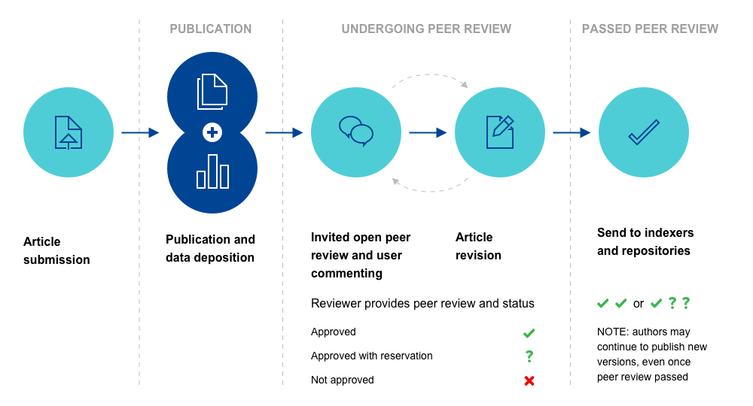
An innovative publication model
Author-led with checks & support
Plagiarism checks
Authorship criteria
Ethical approval
Adherence to policies & guidelines
Language review
Data availability
Analysis of the method
Prepublication checks

Slide 19
Benefits for researchers

Slide 20
Open peer review: a win-win situation

Slide 21
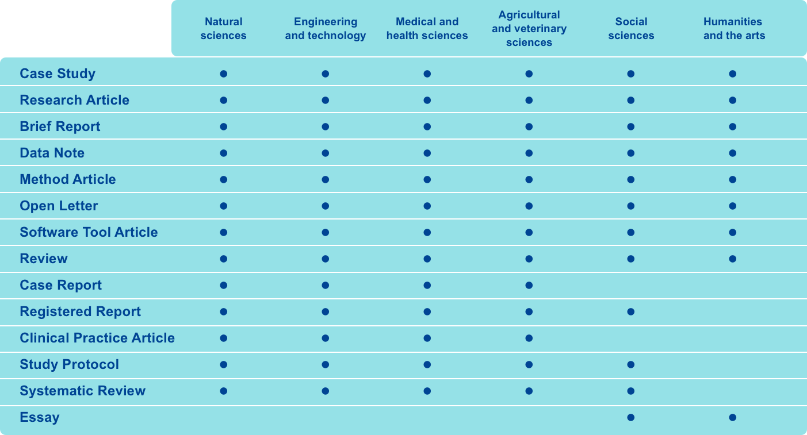
Research supported across all disciplines

Slide 22
The peer review process
Reviewers are suggested by article authors, with the editorial team ensuring they meet necessary criteria (incl. conflicts of interest) or suggesting additional expertise
An extensive list of questions, which must be answered, guides the review process, appropriate for different domains; there is also a reviewer code of conduct to be followed
Once all necessary reviews performed, the editorial team checks for process, content, language and correct status, and completes the publishing process

Slide 23
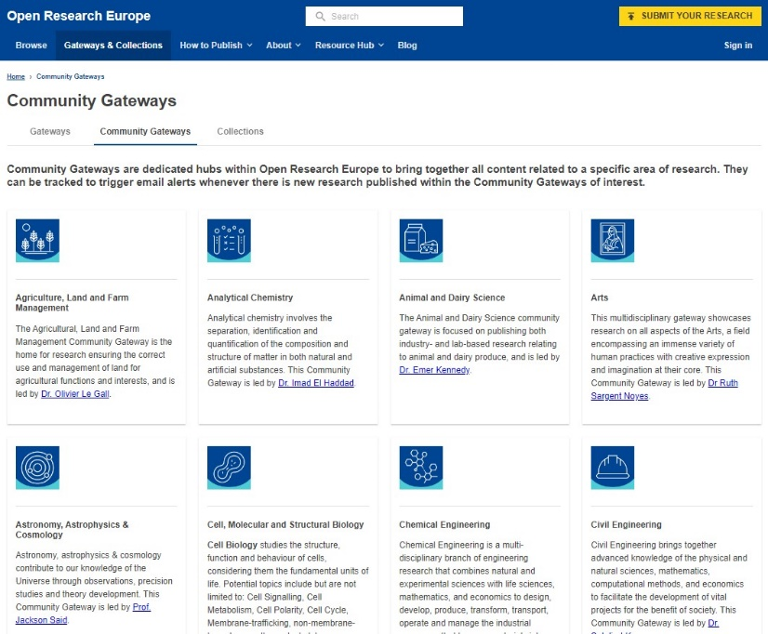
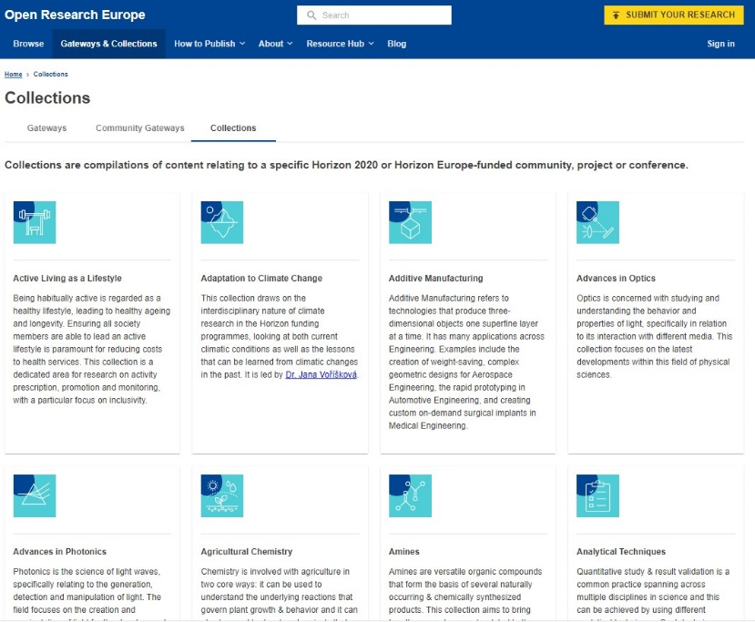
Research Communities in ORE

Slide 24
A vision for the future of ORE shared with other funders
A top-quality, trusted collective OA publishing service for the public good (non-profit)
Collectively driven, owned and supported by research funders and research institutions, as a service for researchers
No author fees and ambition for a publishing service without eligibility barriers, e.g. of funding or institutional affiliation, only meeting scientific and publishing standards
Supported by an open source infrastructure
Keep it optional yet attractive to researchers’ needs
Support diversification of publishing landscape (not replace, rather enrich)
Discussions with national funders and other stakeholders. 2024 crucial for developments

Slide 25
We invite you as MSCA4Ukraine grantees to publish in ORE
Test ORE to get first publishing experience with research articles but also with e.g. case studies, method protocols… (see How to publish)
Try being a reviewer, as ORE is a place that acknowledge their work and allows reports to be cited (volunters may contact editorial@open-research-europe.ec.europa.eu)
Consider starting a collection, if a group of researchers or projects exist that reflect specific and shared research interests that need to ‘find a publishing home’

Slide 26
Thank you
© European Union 2023
Unless otherwise noted the reuse of this presentation is authorised under the CC BY 4.0 license. For any use or reproduction of elements that are not owned by the EU, permission may need to be sought directly from the respective right holders.

