Slide 1
Ukraine Digital: “Ensuring academic success in times of crisis” funded by:
Prof. Dr. Sören Auer (TIB/LUH)
Margret Plank (TIB)
Nataliya Butych (LUH)

Slide 2
TIB – Leibniz Information Centre for Science and Technology:
Facts, numbers, fields of action
German National Library of Science and Technology
Digital Infrastructures
Services
University library of Leibniz University Hannover
Research
Development
World‘s largest specialised library with unique resources
> 600 people
Knowledge and Technology Transfer
> 30 nations
> 50 mio € budget

Slide 3
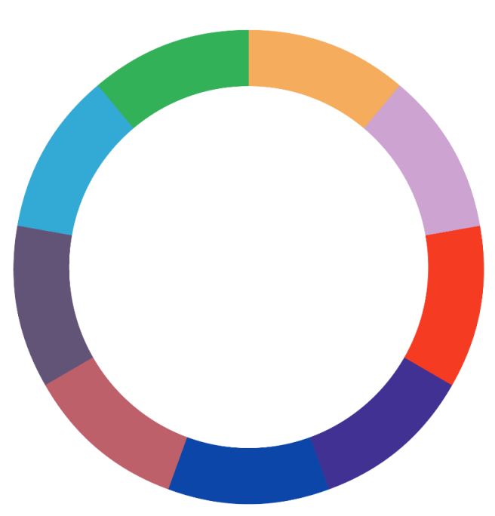
TIB & Open Science
Open Source
Open Access
Open Evaluation
Open Infrastructures
Open
Science
Citizen Science
Open Educational Resources
Open Innovation
Open Data
Open Labs

Slide 4
TIB & Scientific Work
Research Information System / VIVO
AV Portal
Open Science
ReNaTe – Repositoy for Science and Technology
Subject Information Services – FIDs
Finding Topic /
Topic Assingnment
Information Literacy / Consulting Workshops / Training
Digital Archiving
Information
Procurement
TIB ConRec – Conference Recording Service
Distribution
TIB Portal
Scientific Work
twillo / OERSI
TIB Open Publishing
Full Text Supply / Licences / DEAL
Research Data Management / NFDI
ConfIDent
Text Production
Information Processing
PID- / Metadata Services
Open Research Knowledge Graph – ORKG
NexGenBooks
eDOER
Text- /
Data Mining
Learning and working space

Slide 5
Projects with Ukraine
Ukrainian-German Workshop 3-5 July 2023 → joint research topics
Possible Funding Programs (such as DFG – German National Research Foundation)
Conferences (on Computer Science & Information Technologies, Data Driven Medicine, Modern Machine Learning Technology & Data Science, Computational Linguistics and Intelligent Systems,…)
Project Ideas (Evaluation and Profiling of AI Systems, Explainable AI, Text and Image Mining, Fake Narratives,…)
DigiUni Project
EU-funded Erasmus+ project for universities to strengthen the digital environment for higher education in Ukraine
5 mio € for four years; coordinated by Taras Shevchenko National University in Kyiv
With stakeholders from six EU Member States (Belgium, Czech Republic, France, Germany, Poland, Spain) and 15 Ukrainian partners
DigiUni project will develop a powerful digital platform for Ukrainian universities → the "DigiPlatform" will create a digital learning environment to develop training on online teaching techniques and adapt learning content for online or virtual teaching

Slide 6
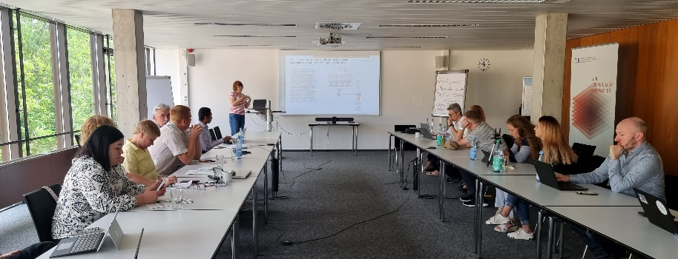
OER with Ukraine: Project Overview
Project Responsibility:
Prof. Dr. Sören Auer, LUH / TIB
Coordination:
N. Butych, M. Plank, S. Matern
Funding line: DAAD - Ukraine digital –
Ensuring Study success in times of crisis
Duration: 1.1.-31.12.2023
Scholarships: 19 (17 in Ukraine,
2 in Germany)
On-Campus-Workshop in Hannover: 3.-6.07.23
(12 participants from Ukraine)
Builds on the experiences of the 1st phase of OER with Ukraine in 2022
https://www.l3s.de/research-at-l3s/all-projects/oer-with-ukraine_informatics

Slide 7
Project Participants
Leibniz University Hannover, represented by
Leibniz Joint Lab Data Science and Open Knowledge
L3S Research Center
Institute of Photogrammetry and Geoinformation
International Office
TIB – Leibniz Informational Center for Science and Technology, University Library
Taras Shevchenko National University of Kyiv (TSNU)
Ukrainian State University of Science and Technology, Dnipro (USUST)
Kharkiv National University of Radio Electronics (KNURE)
Lviv Polytechnic National University (LPNU)
National Aerospace University – "Kharkiv Aviation Institute“ (KhAI)

Slide 8
Project Goals
Creation of Open Educational Resources in computer science and integration in the partner universities curricula supports the Ukrainian students for better access to education during crisis times
Involvement of Ukrainian refugee scientists and teaching staff in the creation process contributes to expansion of learning opportunities for Ukrainian students and promotes internationalization
Provision of sustainable digital infrastructure for OER such as TIB AV-Portal and Searchindex OERSI strengthens German-Ukrainian cooperation in higher education
Creation of the necessary foundations and instruments for further digitization, visibility and support of Ukrainian universities contributes to the internationalization, digitization and openness
Digital and professional competencies of both German and Ukrainian partner institutions contribute to the development of joint open educational resources

Slide 9
Work Program
Creation of 120 OER (Video lessons and other learning resources)
Videos are made accessible and stored permanently at TIB AV portal, receive a DOI and are subtitled in English / Ukrainian
Other learning materials are made available on the OER portal twillo.de
The metadata of all learning materials is harvested by the OER search index (OERSI). Its interface is also translated in Ukrainian.
The project results (OER) are integrated into the existing structures and remain visible, findable, reusable and citable for all students and teachers from Ukraine and worldwide
A series of eTrainer webinars are held to develop the digital competencies regarding OER of the Ukrainian participants

Slide 10
Sustainable Infrastructure:
TIB AV-Portal
Open portal for sharing scientific videos
More than 40,000 quality-checked videos (German / English / Ukraine)
All scientific subjects, with a focus on architecture, chemistry, computer science, physics, mathematics, engineering
Conference and lecture recordings, teaching/learning videos, experiments, video abstracts, simulations, visualized research data, documentaries
Predominantly under Creative Commons licenses (CC)

Slide 11
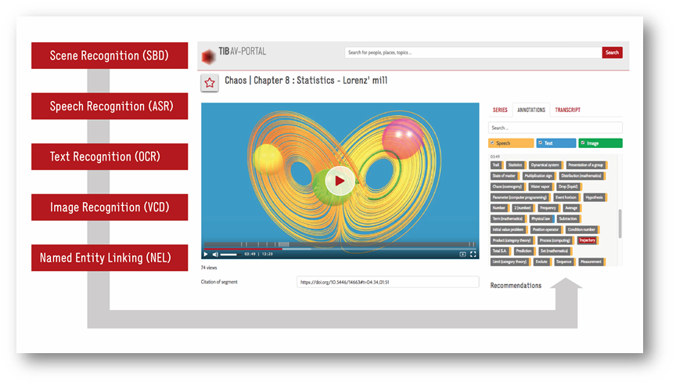
TIB AV-Portal: Services
Hosting of the videos in the video repository
Standardized metadata
Permanent citation capability: DOI / MFID,
ORCID, ROR, EIDR
Linking to accompanying materials/articles
and vice versa via DOI
Embed codes
Long-term archiving in Rosetta / ExLibris
Legally compliant publishing practices / license management
Described in RDF (published as Linked Open Data)
Provided free of advertising
Provided in compliance with data protection laws

Slide 12
Project Channel OER with Ukraine
Channel OER with Ukraine
162 videos from biomedicine, material science, AI, Big Data, Knowledge Engineering, Neural Networks and Deep Learning, IT Management, Programming, Cloud Technology, Web Design, Image Analysis….
All videos are subtitled in English and Ukrainian
Project Intro / Outro / Logo
Described with standardized Metadata
Licence Agreement (CC-licenced)
Link to Project Channel OER with Ukraine:
https://av.tib.eu/publisher/Projekt+%27Open+Education+Resources+with+Ukraine%27

Slide 13
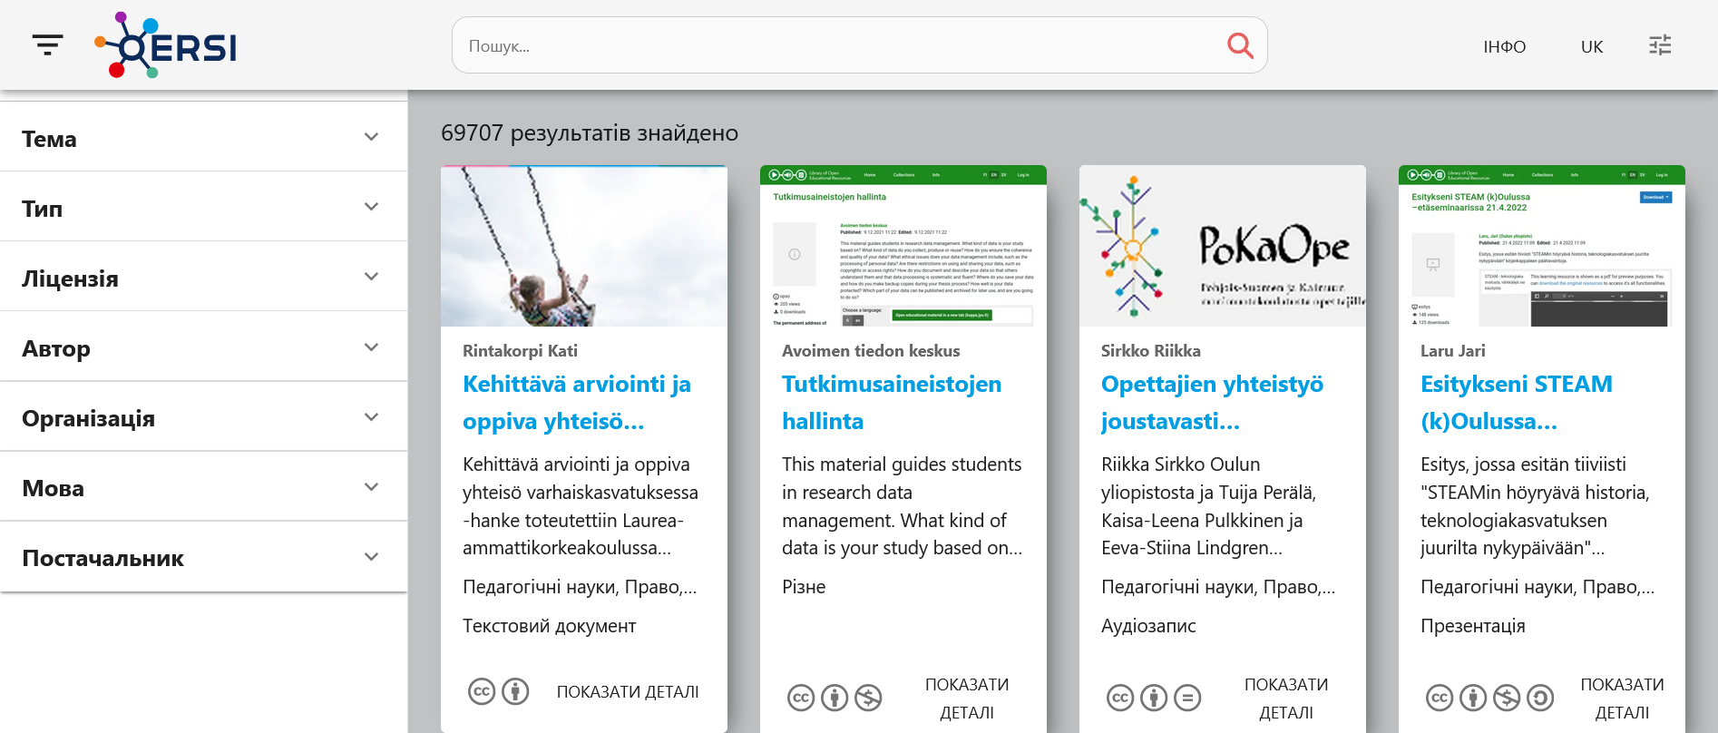
OER Search Index OERSI
International Search index for OER in higher education
Productive operation since 04/2021
approx. 70.000 educational resources from more than 80 universities from 17 sources, incl. TIB V-Portal
Integrated e.g. in OER Portal twillo.de
Interface in DE/EN and Ukrainian
Cross-lingual search
Open Source on Gitlab
https://gitlab.com/oersi
www.oersi.org

Slide 14
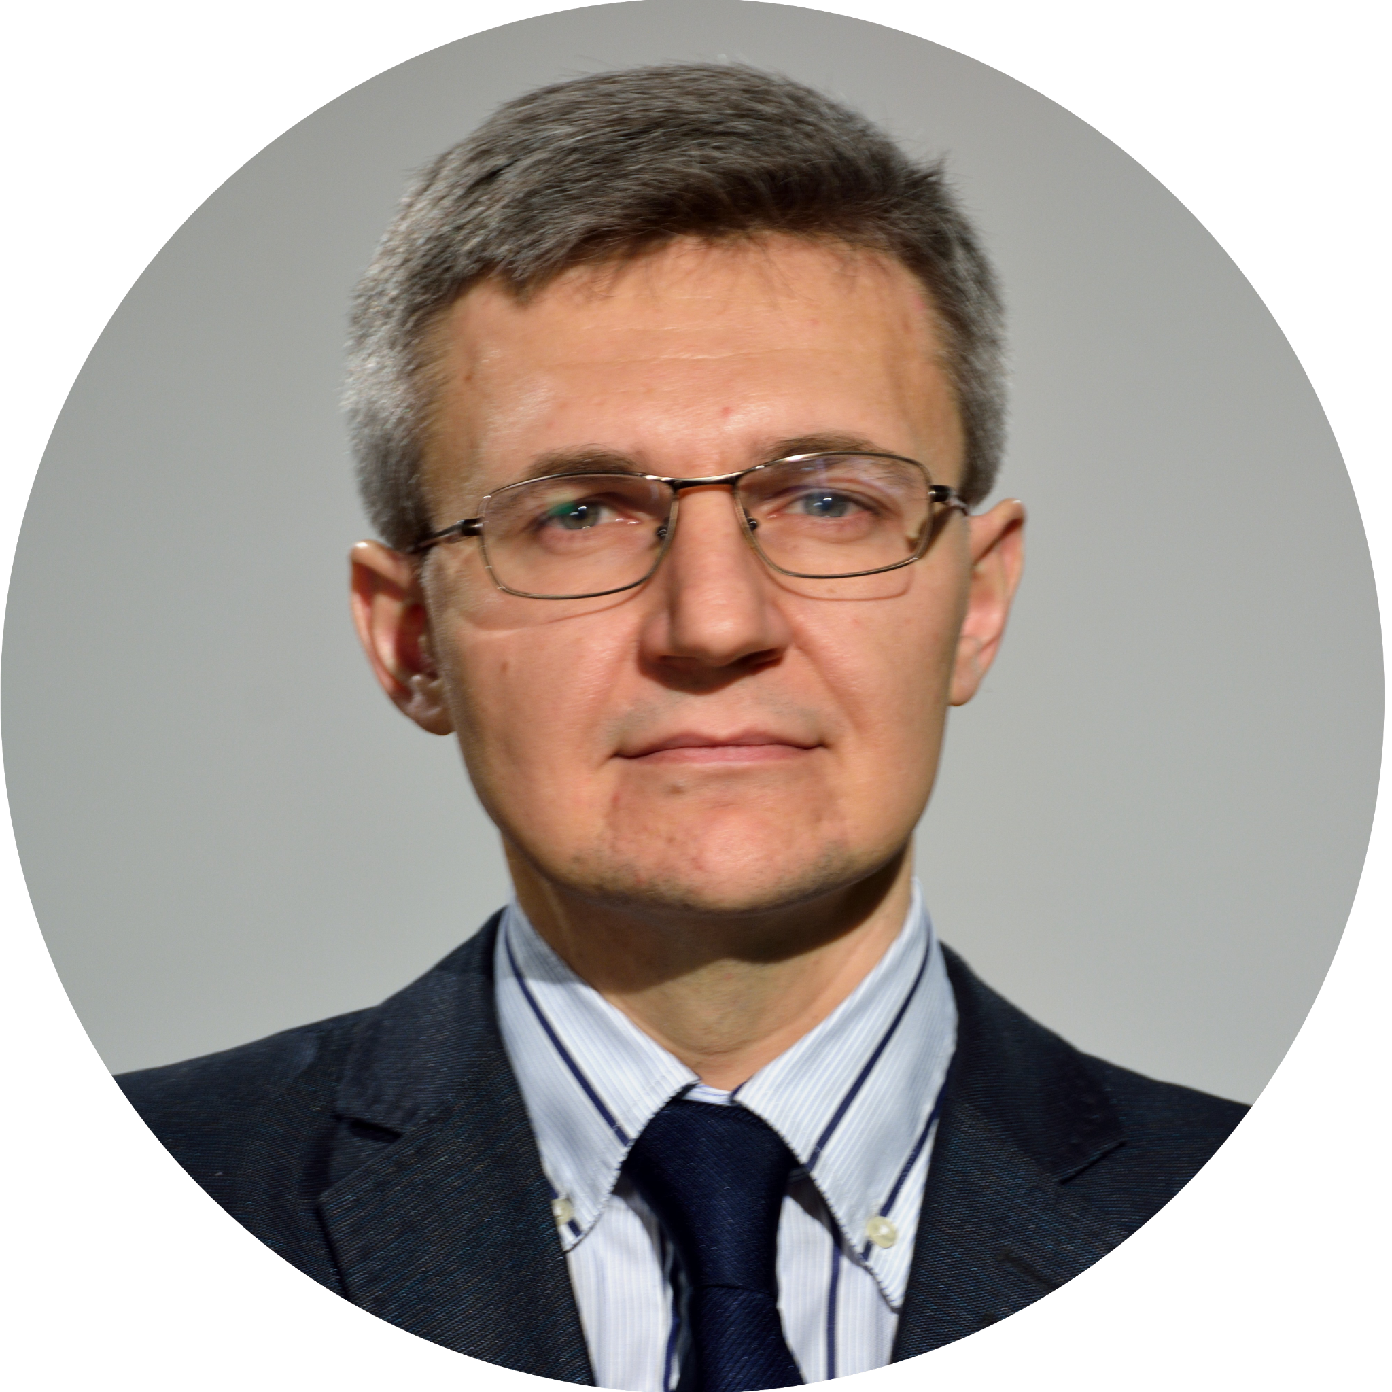
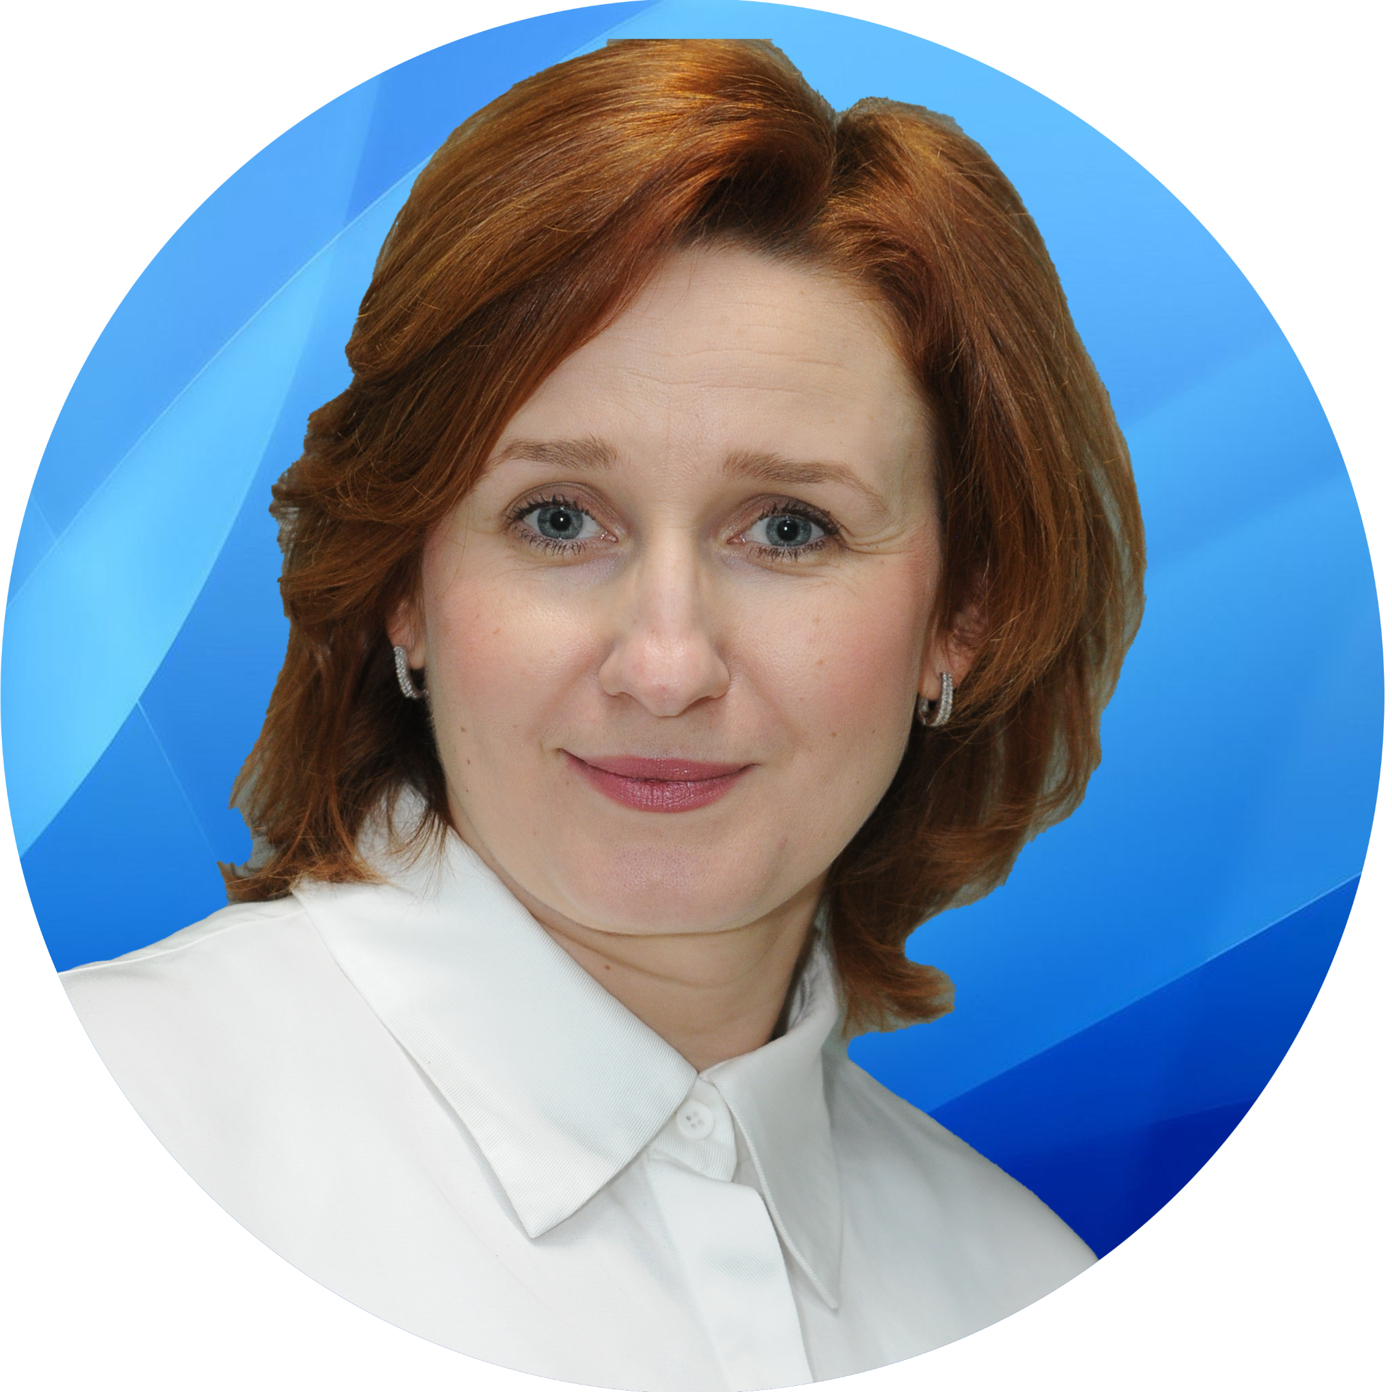
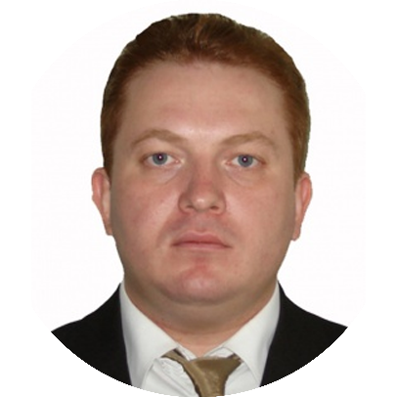
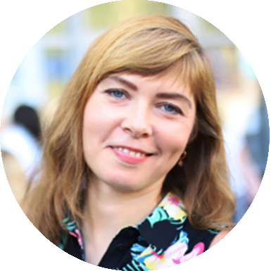
Taras Shevchenko National
University of Kyiv (TSNUК)
Associated institutions and academic staff:
Institute of Journalism
As. Prof. Yevhen Tsymbalenko
Institute of High Technologies, Vice-Rector
Prof. Ganna Tolstanova
Faculty of Computer Science and Cybernetics
Prof. Oleksandr Marchenko
Faculty of Information Technology
Prof. Nataliia Tmienova
Photo: Volodymyr Bondar / Wikimedia Commons / CC BY-SA 4.0
Notes:
14

Slide 15
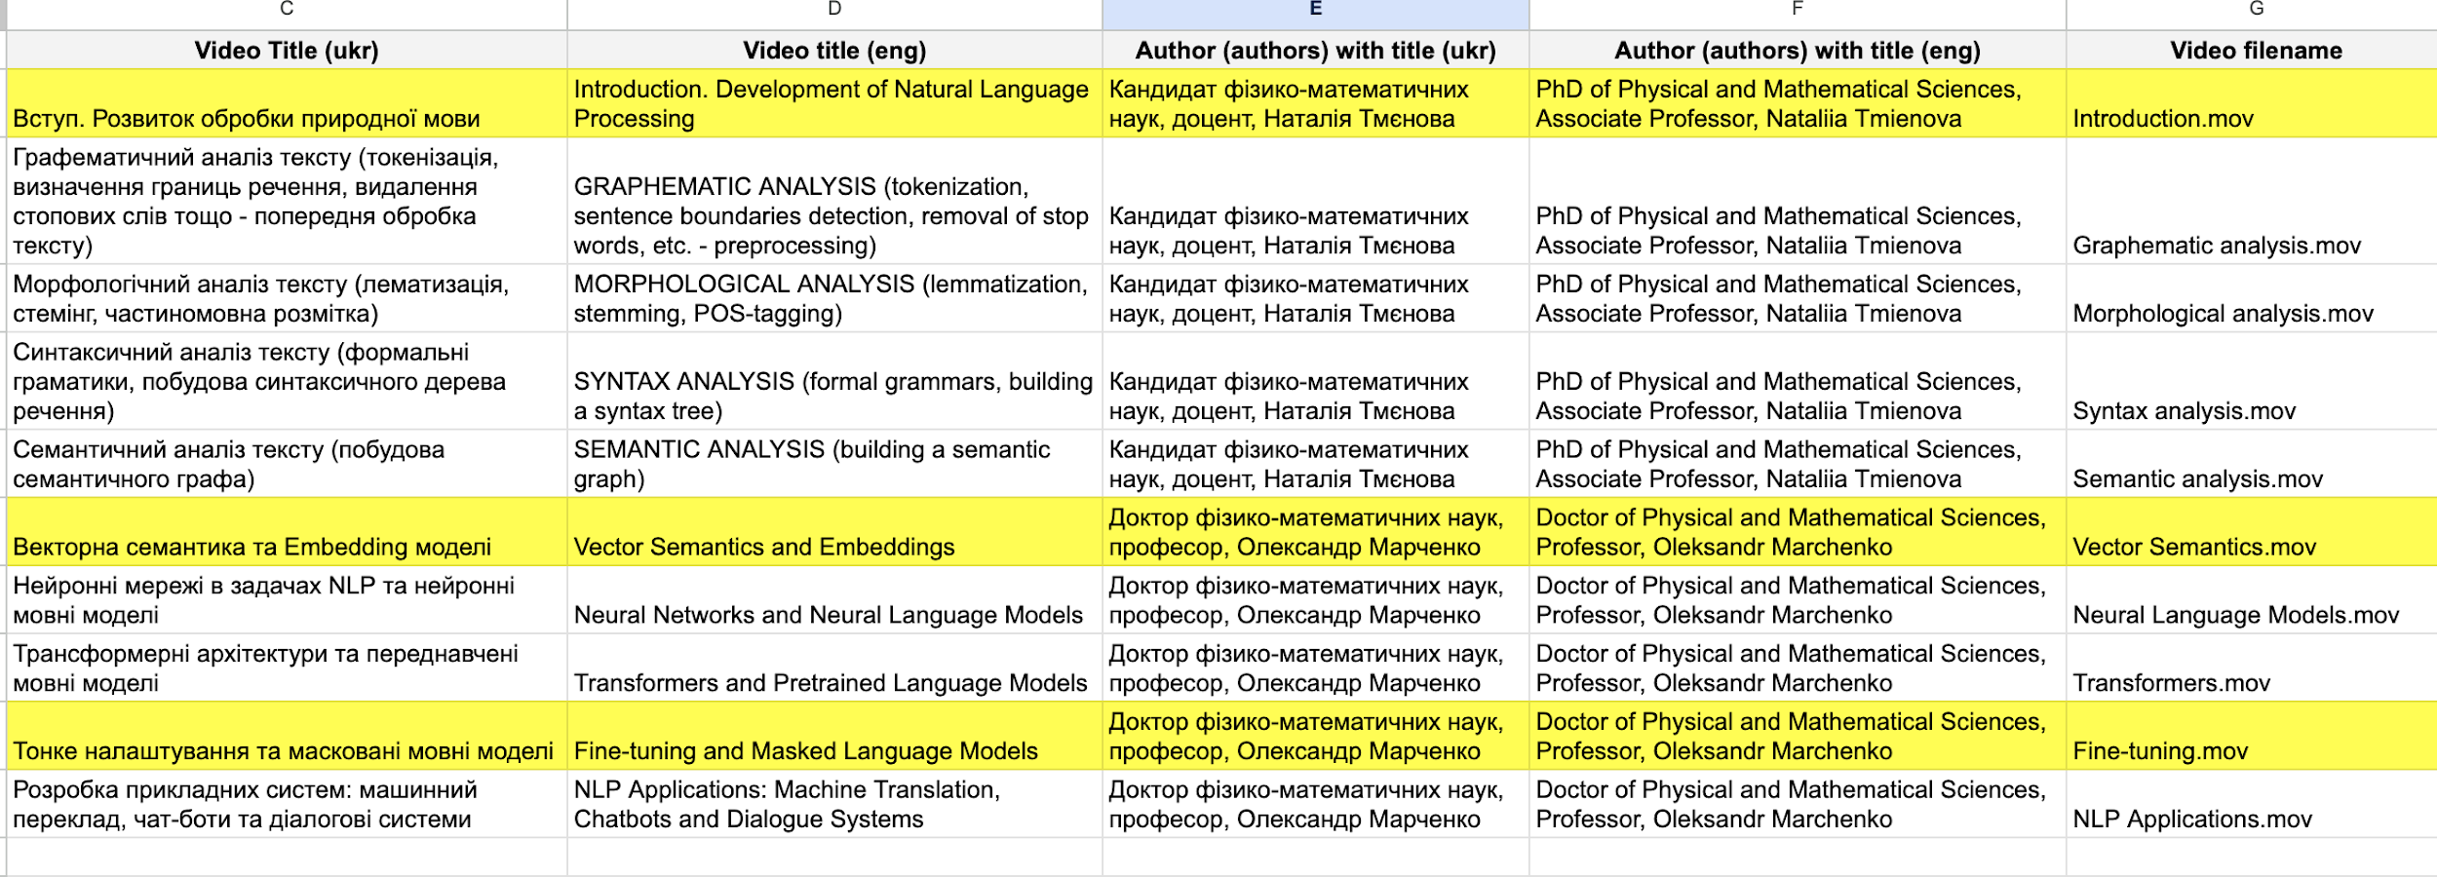
Taras Shevchenko National
University of Kyiv (TSNUК):
Contributions
10 video lectures on the topic „Natural Language Processing“
Photo: Volodymyr Bondar / Wikimedia Commons / CC BY-SA 4.0
Notes:
15

Slide 16
Taras Shevchenko National
University of Kyiv (TSNUК):
Contributions
Coordination of postproduction , consultation for Ukrainian partners on technical issues
22 Mar. 2023, 14:00
1. Videolectures picture building and recording.
29 Mar. 2023, 14:00
2. Subtitling and postproduction.
Photo: Volodymyr Bondar / Wikimedia Commons / CC BY-SA 4.0
Notes:
16

Slide 17
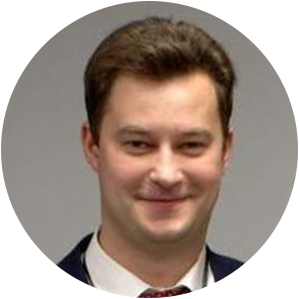
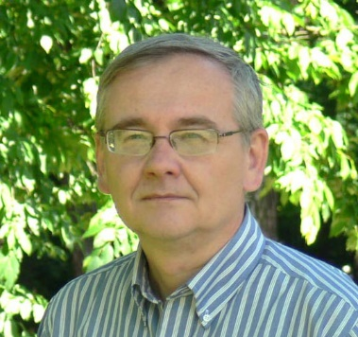
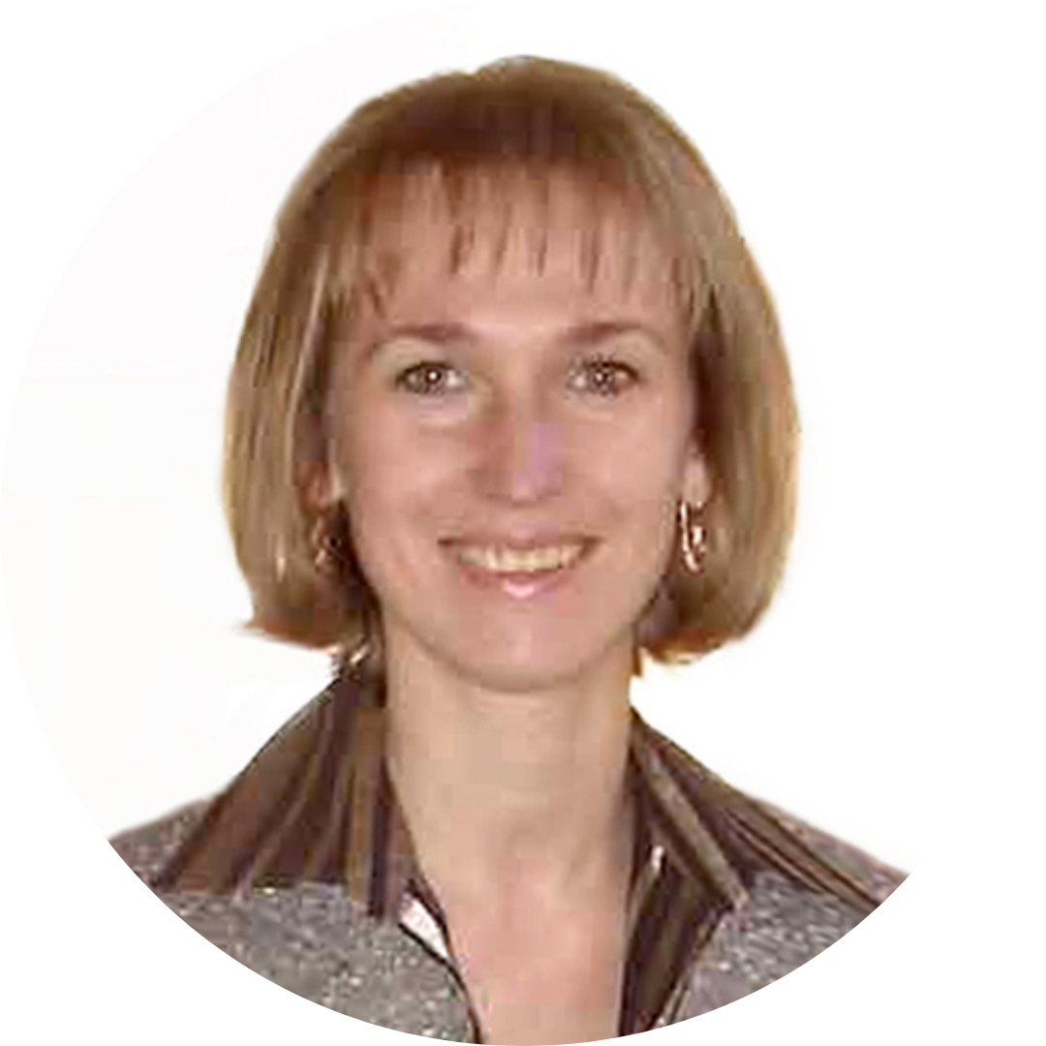
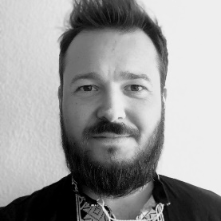
Lviv Polytechnic National University
(LPNU)
Associated institutions and academic staff:
Information Systems and Networks Department
Department of Artificial Intelligence
Contributions:
Video lectures on:
Cloud technologies,
Computer networks,
IT product management,
IT project management,
Neural networks and deep learning,
Big data and machine learning.
Photo: Konstantin Brizhnichenko / Wikimedia Commons / CC BY-SA 4.0
Notes:
17

Slide 18
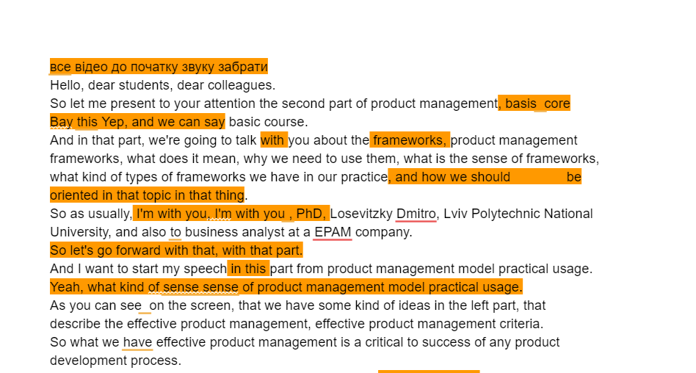
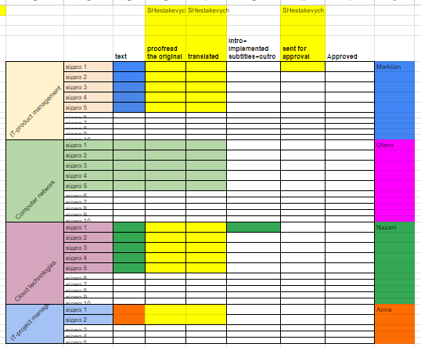
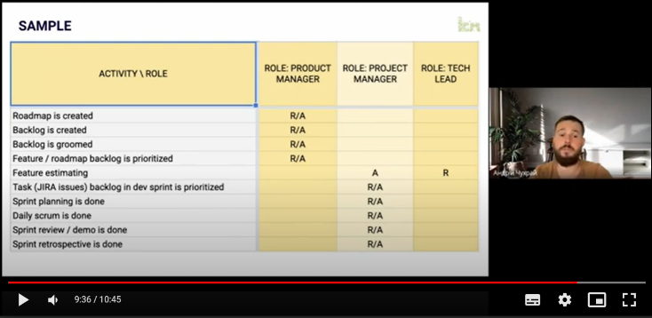
Lviv Polytechnic National University
(LPNU)
Photo: Volodymyr Bondar / Wikimedia Commons / CC BY-SA 4.0
Notes:
18

Slide 19
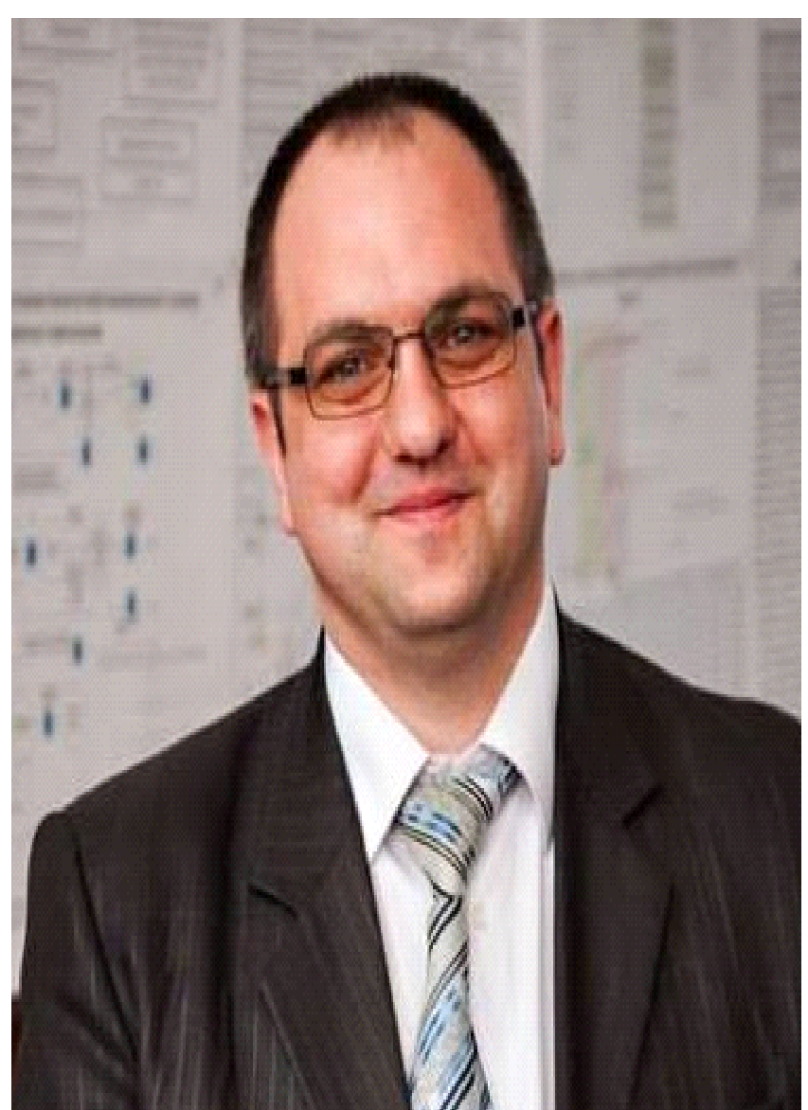
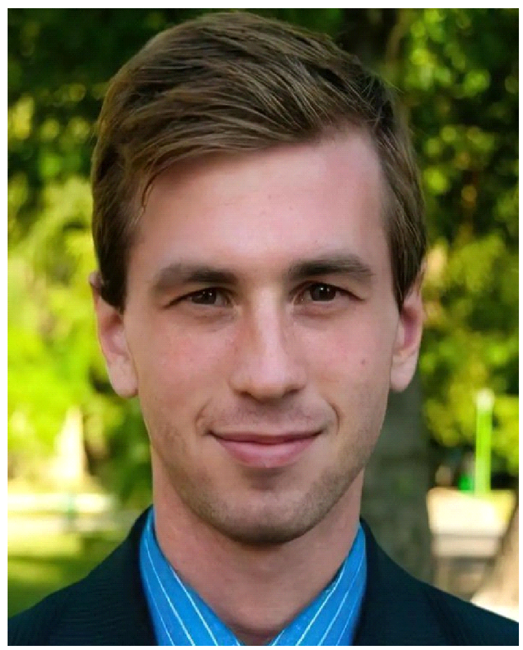
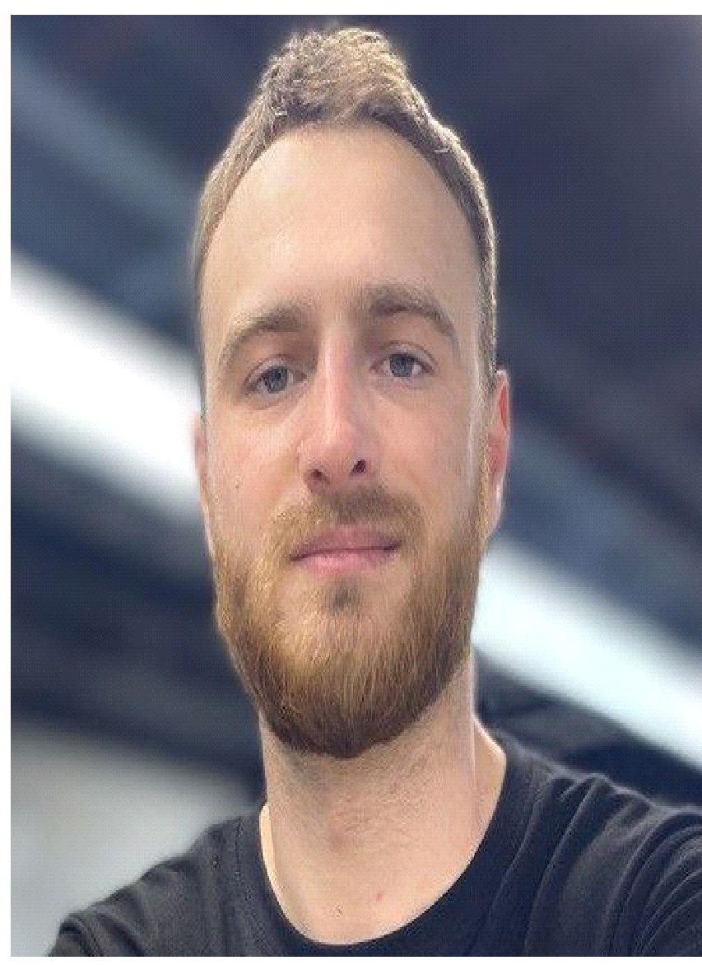
National Aerospace University –
Kharkiv Aviation Institute (KhAI)
Associated institutions and academic staff:
Department of Aircraft Radio Engineering System Design: Prof. Volodymyr Pavlikov
Department of Information Technologies of Design: Prof. Dmytro Kritskiy
Contributors:
As.Prof. Dmytro Kritskiy
Faculty Dean
As.Prof. Oleksandr Karatanov
Maksym Bychok
PhD Student
Notes:
19

Slide 20
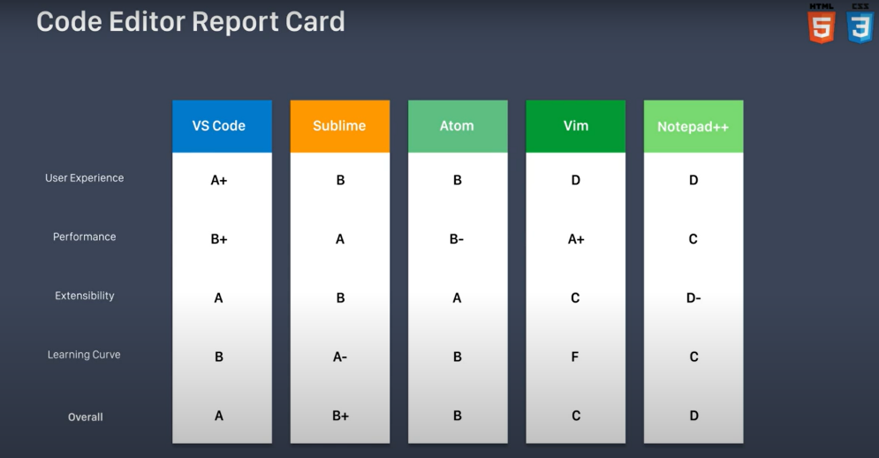
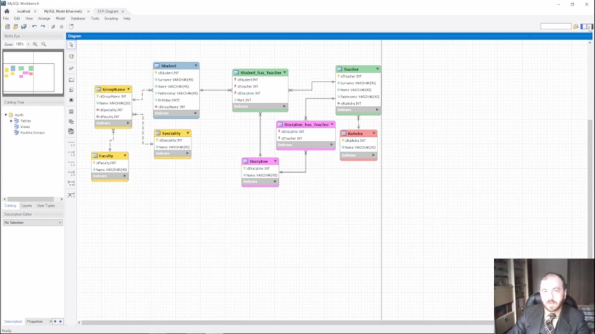
National Aerospace University –
Kharkiv Aviation Institute (KhAI)
10 video lectures on the topic „Web technologies and design“
10 video lectures on the topic „Fundamentals of programming“
10 video lectures on the topic „Databases“
Photo: Volodymyr Bondar / Wikimedia Commons / CC BY-SA 4.0
Notes:
20

Slide 21
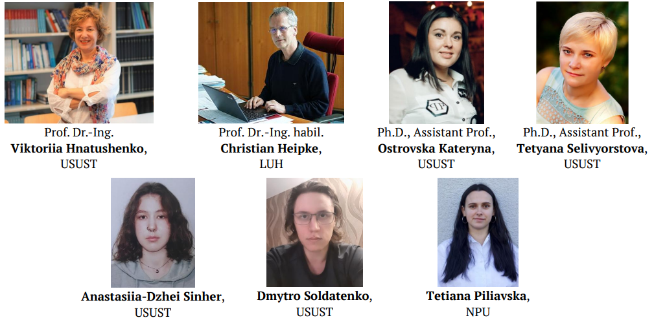
Ukrainian State University of Science
and Technology (USUST)
Associated institutions and academic staff:
Institute of Industrial and Business Technologies
Prof. Viktoriia Hnatushenko
As. prof. Kateryna Ostrovska
As. prof. Tetyana Selivyorstova
Contributors:
Notes:
21

Slide 22
Ukrainian State University of Science
and Technology (USUST)
10 video lectures on the topic "Neural Networks", with IPG (LUH)
10 video lectures on the topic "Artificial Intelligence", with IPG (LUH)
Photo: Volodymyr Bondar / Wikimedia Commons / CC BY-SA 4.0
Notes:
22

Slide 23
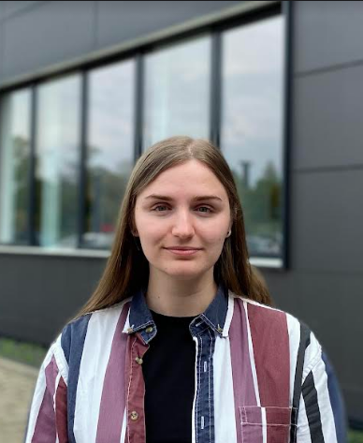
Kharkiv National University of Radio Electronics (KhNURE)
Associated institutions and academic staff:
Department of Biomedical Engineering
Prof. Oleh Avrunin
Contributors:
Oleksandra Hubenia
Master Student
Olha Isaieva
Master student
Prof. Oleh Avrunin
Dept. Coordinator
Andrii Sokolov
PhD Student
Photo: Victor Vizu / Wikimedia Commons / CC BY-SA 3.0
Notes:
23

Slide 24
Kharkiv National University of Radio Electronics (KhNURE)
2 video lectures on the topic „Stereovision video content“
2 video lectures on the topic „IT functional medical diagnostics“
2 video lectures on the topic „IT in the surgical intervention planning“
Photo: Volodymyr Bondar / Wikimedia Commons / CC BY-SA 4.0
Notes:
24

Slide 25
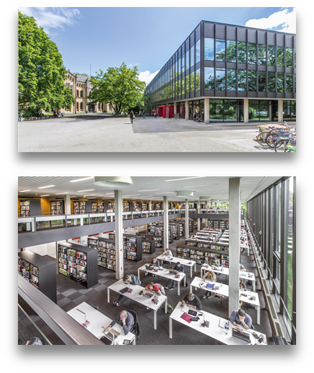
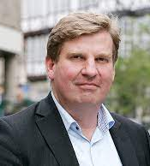
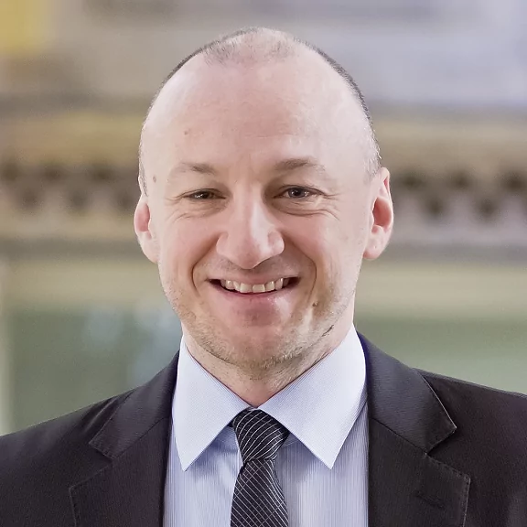
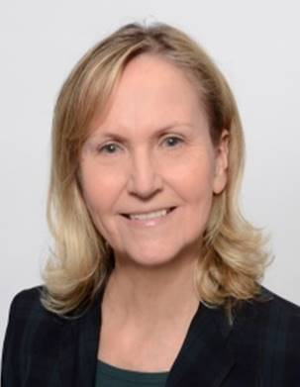
TIB – Leibniz Information Centre
for Science and Technology / LUH
Associated institutions and academic staff:
Department of Data Science Prof. Dr. Sören Auer
Research Group Visual Analytics Prof. Dr. Ralph Ewerth
Contributors:
Prof. Sören Auer
Director TIB
Prof. Ralph Ewerth
Head of Research Group Visual Analytics
Margret Plank
Head of Lab Non-Textual Materials
Photo: Victor Vizu / Wikimedia Commons / CC BY-SA 3.0
Notes:
25

Slide 26
TIB – Leibniz Information Centre
for Science and Technology / LUH
10 video lectures on the topic „Knowledge Engineering and Semantic Web“
10 lectures on the topic “Visual Analytics”
Photo: Volodymyr Bondar / Wikimedia Commons / CC BY-SA 4.0
Notes:
26

Slide 27
MORE INFORMATION av.tib.eu
Twillo.de
OERSI.org
Contact
Soeren.Auer@tib.eu
Margret.Plank@tib.eu
Nataliya.Butych@zuv.uni-hannover.de

